Slide 1
Power BI Interactive Training
This PowerPoint is designed to be an interactive tutorial to Power BI.
Please press F5 on your keyboard to start slideshow.
After starting as a PowerPoint Presentation, please click here to begin

Slide 2
How to navigate this Interactive PowerPoint Presentation
This presentation is designed to be an interactive space while providing information.
Whenever you see a GOLD ringed box, it means you can click or select
an interaction within the presentation.
Click Here to Continue
Click or Select Here
Alternatively, you can also hit the [ENTER] or the [arrow keys] on your keyboard to navigate through animations.

Slide 3
Power BI Interactive Training
Home Page
The goal of this training is to provide a general overview of each of these questions.
How Does Power BI
Work with Seattle U?
Click on How Does Power BI Work With Seattle U for an overview of the Power BI Tool or click on How Do I Navigate Power BI for an introduction on the tools used within Power BI.
How Do I Navigate
Power BI?
You can also click on the icon to return to this page.
Click on the icon to end the presentation.

Slide 4
How Does Power BI Work with Seattle U?
InformSU
Continue
This module will provide an overview on how InformSU is working to support the implementation of Power BI by providing data, reports, and trainings.

Slide 5
How does Power BI work with InformSU?
InformSU
Here is an overview of the pages in this module.
Select any of the boxes below to navigate directly to that page or Continue to begin.
What is Power BI?
How Does Power BI Visualize Data?
What is InformSU?
Continue
How has InformSU Reporting Evolved?
How does InformSU support SU with data?
What is coming from InformSU?
How will staff and faculty at Seattle U access Power BI?
Examples of User Roles for SU
Questions? Contact Us

Slide 6
What does Power BI do?
InformSU
Power BI is a business analytics service that delivers insights to enable fast, informed decisions.
Transform data into stunning visuals and share them with colleagues on any device.
Visually explore and analyze data—on-premises and in the cloud—all in one view.
Continue
Collaborate on and share customized dashboards and interactive reports.
Scale across your organization with built-in governance and security.

Slide 7
Visualizations of Data
InformSU
How does visualizing data help users?
Visualizations allow data to be represented in different ways, leading to insights into data relationships that may not be easily seen.
Continue
Power BI allows users to create and adjust visualizations based on their own needs as they look at data.
Users will be able to look at data from different perspectives and find insights into data relationships that help them make better informed decisions.

Slide 8
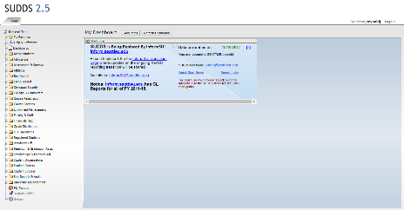
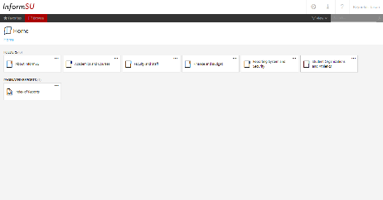
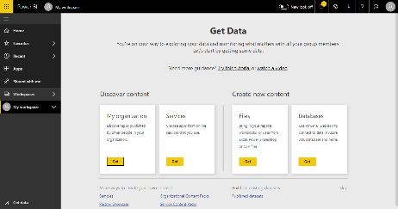
How has InformSU reporting evolved?
InformSU
A timeline of InformSU reporting processes to present day.
Pre-2017
Academic Year
2017
Academic Year
2019
Academic Year
Pre-InformSU - SUDDs
InformSU – SSRS
InformSU (Power BI)
Continue
InformSU SSRS

Slide 9
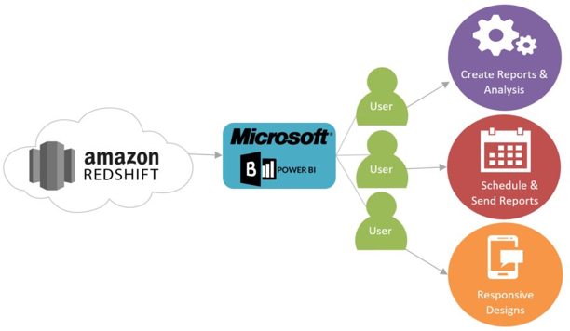
How does InformSU support SU with data?
InformSU
Where is this data coming from?
InformSU aims to combine and present data from a diverse set of sources. Reports supporting enrollment analysis and program review are already available, and throughout the next year, more reports will be rolled out.
Continue
With the start of this academic year, Power BI will act as an analytics tools to access information stored in the new Enterprise Data Warehouse built to replace SUDDS.
Power BI allows users to create reports and analytics, schedule reports to run automatically, send reports, and have dashboards with responsive designs.
Click here for more information on the data warehouse

Slide 10
What support is coming from InformSU?
InformSU
InformSU is working to provide support for Power BI across Seattle University.
InformSU is working to deploy data models on an ongoing basis. For a more detailed look at the upcoming data models rollout on the InformSU website, click here.
Continue
For questions about Power BI, the InformSU website has a Power BI F.A.Q. and Glossary to help with understanding processes and terms here.
The InformSU website posts a schedule of upcoming Power BI office hours along with various training documents here.

Slide 11
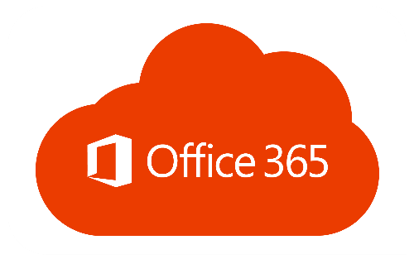
How will staff and faculty at Seattle U access Power BI?
InformSU
Power BI is already available for SU faculty and staff.
Access to PowerBI is provided as part of the office 365 subscription given to all Seattle U faculty and staff.
Continue
Power BI offers a web app, desktop app, and mobile app for convenient access across varying needs
* Mobile app access for Seattle U users coming soon

Slide 12
Examples of User Roles for SU
InformSU
While not definitive, Power BI users may fall into one of many roles.
General User
Consumer of operational reports in SUDDs and InformSU
MAY want to interact with reports beyond what is available
Labeled as a “consumer” in Microsoft Power BI training manuals
High-level executives who use delivered reports or dashboards to answer complex questions with data.
Mainly looking at reports in the Power BI service
Labeled as a “consumer” in Microsoft Power BI training manuals
Continue
Managerial User
Utilizes queries, formulas, transformations, and visualizations to analyze data
Develops own reports and dashboards to be shared with others
Labeled as a “report designer” in Microsoft Power BI training manuals
Advanced User

Slide 13
Questions?
InformSU
InformSU is here to help! Contact us with any questions about…
InformSU platform
Power BI Reports
Operational Records
Access
Data Validation
Enhancements
Trainings (signup through Engage SU)
Return to Home Screen
Click here to send us an email at informsu@seattleu.edu

Slide 14
How Do I Navigate Power BI?
Navigate
Continue
This module will provide an overview on logging in to Power BI, the tools available within the web app, navigating a sample report, and suggestions moving forward.

Slide 15
How Do I Navigate Power BI?
Navigate
Here is an overview of the pages in this module.
Select any of the boxes below to navigate directly to that page or select Continue to begin.
Accessing the Power BI Web App
Navigating the Power BI Workspace
Continue
Opening a Power BI Report
Overview of a Power BI Report
Suggestions for Charting a Power BI Report
Training Resources

Slide 16
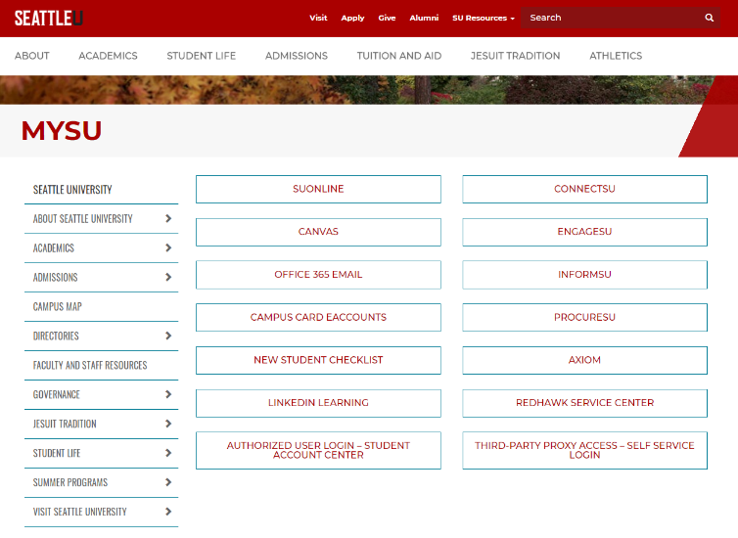
Accessing the Power BI Web App
Navigate
To access the PowerBI Web App, open your internet browser
and enter the address…
app.powerbi.com
seattleu.edu/mysu/
& click on InformSU
OR
Continue

Slide 17
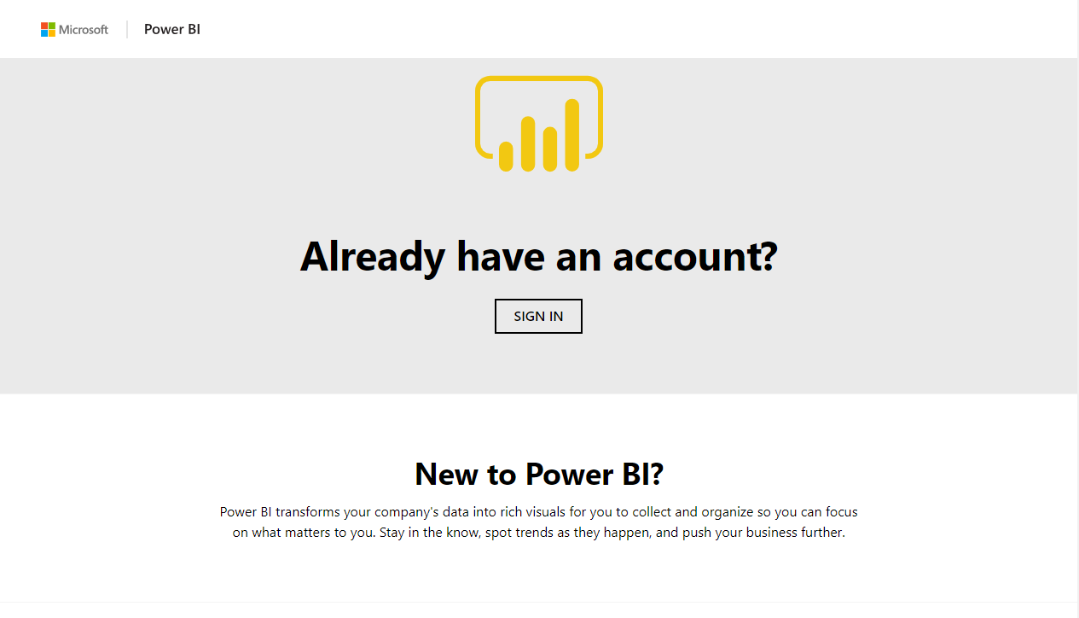
Logging In to Power BI
1) Click Sign In to bring up the login page

Slide 18
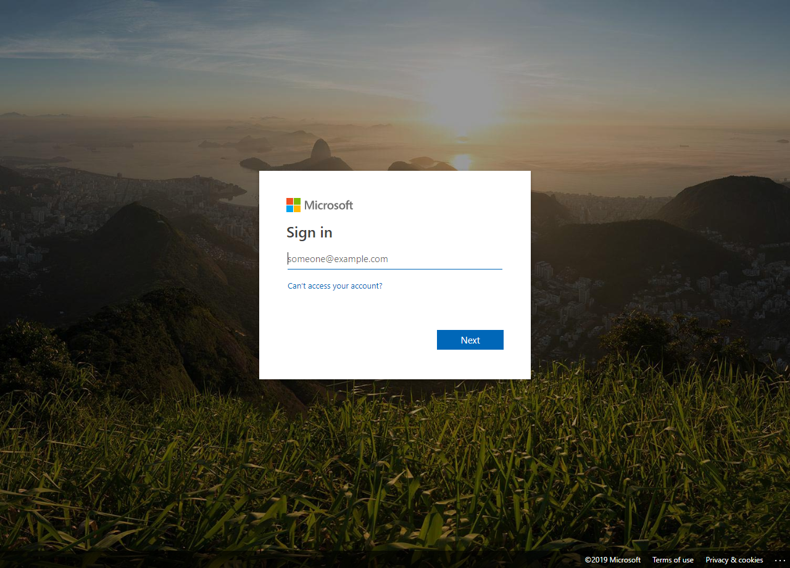
Logging In to Power BI
1) Click Sign In to bring up the login page
2) Log in with your SU credentials
name@seattleu.edu

Slide 19
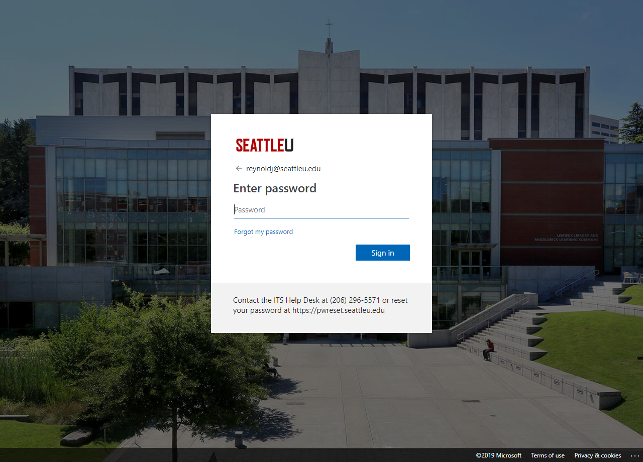
Logging In to Power BI
1) Click Sign In to bring up the login page
2) Log in with your SU credentials
**********
3) Enter your SU login password to continue

Slide 20
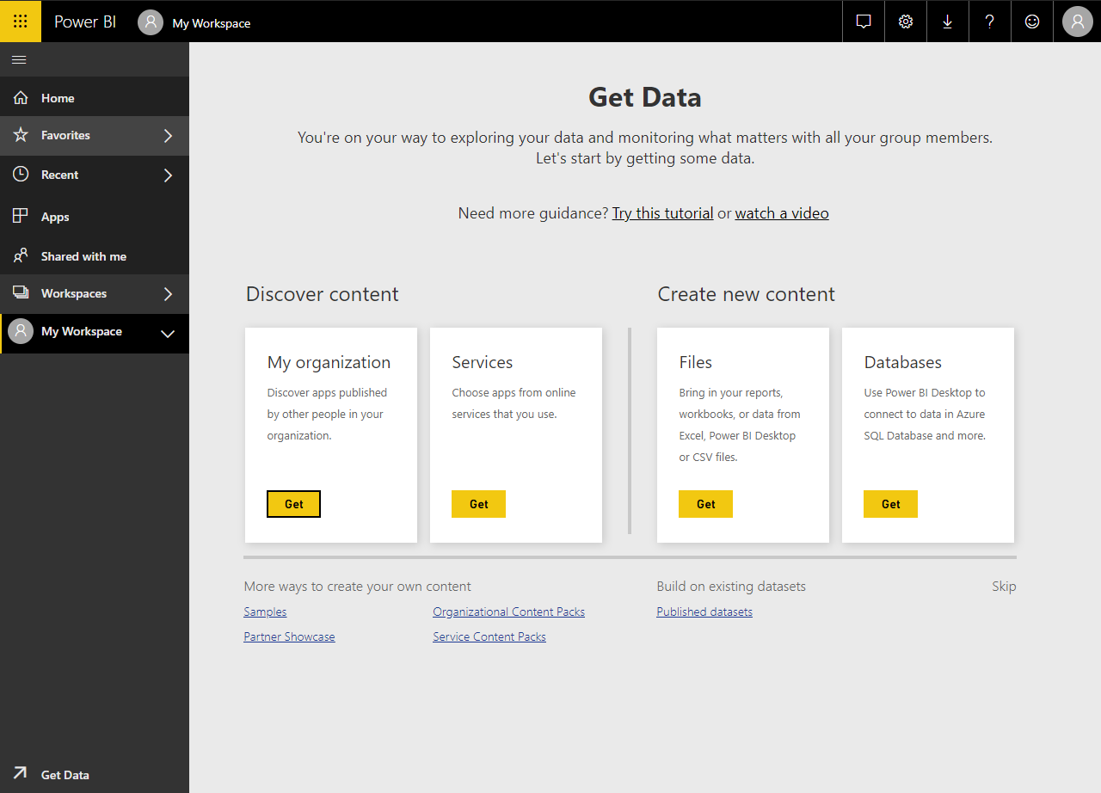
Navigating the Power BI Webapp Workspace
When you first open Power BI, you may see this default screen. This is the Power BI dashboard, but this default page is not the most helpful.
You will be using the toolbar here to navigate through the functions of the Power BI Webapp.
Click on the Home button to go to the home page.

Slide 21
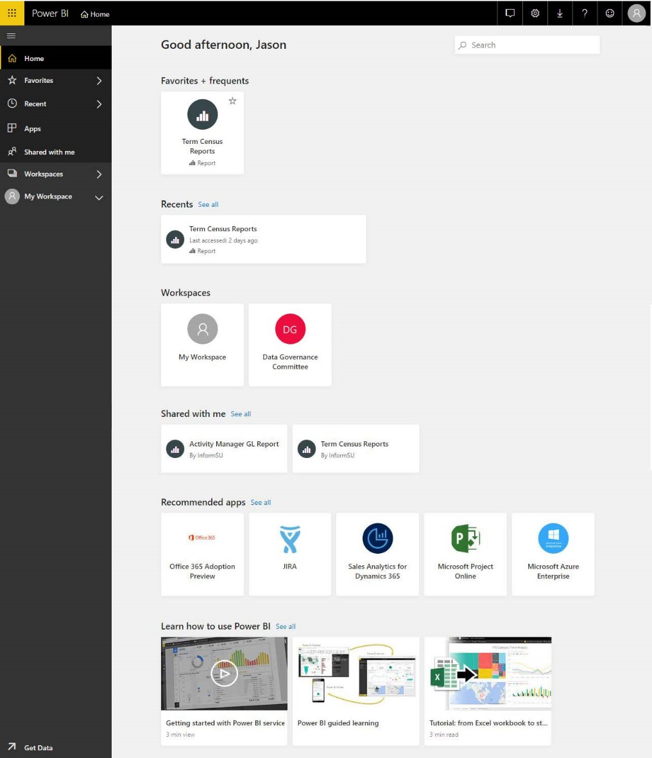
Navigating the Power BI Workspace
Navigate
Settings
Notifications
Settings
Downloads
Help & Support
Feedback
Profile
This is the main workspace for Power BI.
This screen allows users to navigate the Power BI workspace, pull up reports, and share documents or dashboards with other Power BI users.
Let’s start with understanding the navigation pane.
Continue
Workspace
Displays information based on the toolbar settings. Clicking on an item on the dashboard will open it.
Navigation Pane
The main navigation directory for Power BI.

Slide 22
Navigating the Power BI Workspace
Navigate
Click to explore the different tools of the dashboard.
Home
Home
Explore a Sample Power BI Report
Favorites
Favorites
Recent
Recent
Click on one of the tools to explore the functions of the workspace tools…
…or click here to explore a sample Power BI Report
Apps
Apps
Shared with me
Shared with me
Workspace
Workspace
Get Data
Get Data

Slide 23
Navigating the Power BI Workspace
Navigate
The documents and spaces that appear here will be different per account based on what is created or shared.
Home
Return
This is the landing page with a summary of items from the other navigation pane selections
Favorites
Recent
Apps
Shared with me
Workspace
Get Data

Slide 24
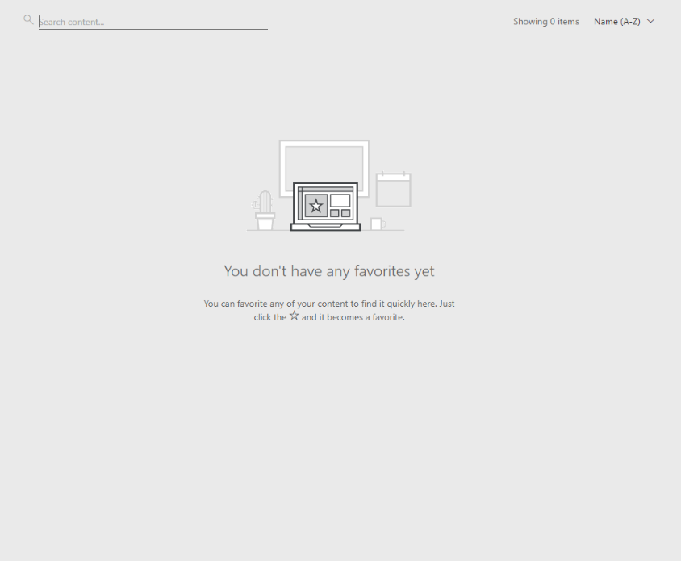
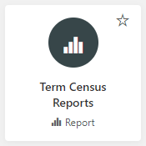
Navigating the Power BI Workspace
Navigate
When you first log in, you won’t have any favorited documents.
To favorite a document, click on the star to add it to the favorite menu.
Home
Continue
Favorites
Users have the ability to favorite reports, dashboards, and other Power BI objects. Once a user has favorited something, use this selection to access those items
Recent
Apps
Shared with me
Workspace
Get Data

Slide 25
Navigating the Power BI Workspace
Navigate
When you first log in, you won’t have any favorited documents.
To favorite a document, click on the star to add it to the favorite menu.
Favorites
Return
Users have the ability to favorite reports, dashboards, and other Power BI objects. Once a user has favorited something, use this selection to access those items
Your favorited document will appear the next time you access or refresh the favorites page.

Slide 26
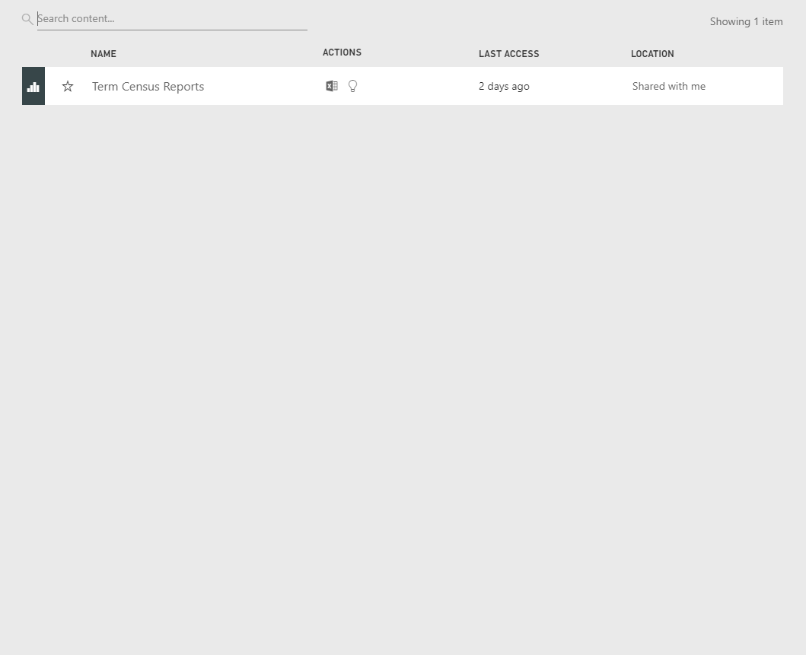
Navigating the Power BI Workspace
Navigate
Recent documents will appear here
Home
Return
Favorites
Since we recently favorited this document, this star will appear here. You can also
unfavorite it by clicking on the star to remove it.
Here users will find Power BI objects you have most recently accessed. Much like the recent history in your web browser, you can quickly find items you have recently used.
Recent
Apps
Shared with me
Workspace
Get Data

Slide 27
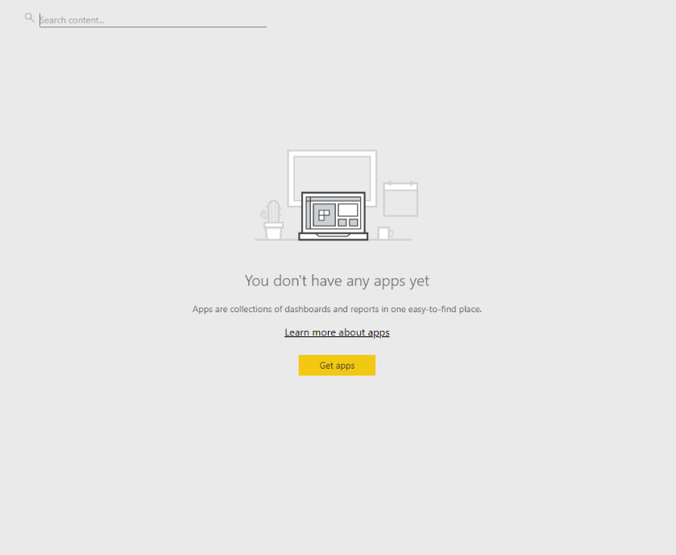
Navigating the Power BI Workspace
Navigate
Home
Return
Favorites
Seattle University is not using this functionality at this time.
Recent
Apps
Shared with me
Workspace
Get Data

Slide 28
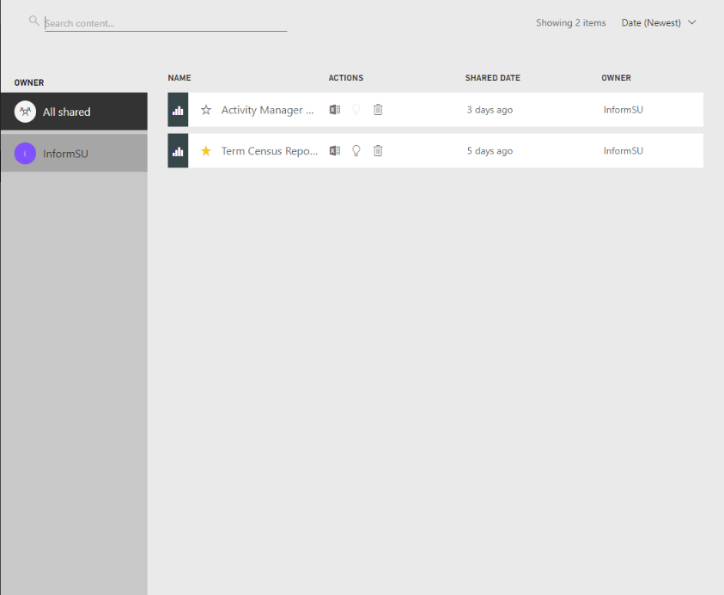
Navigating the Power BI Workspace
Navigate
Official InformSU reporting will be accessed through this tool.
You can also navigate which reports are on the dashboard by clicking on different owner groups.
Home
Return
Favorites
*Unless you are the owner of a report, you can not share a Power BI report with another person. Instead, have the other person contact the original owner of the report for sharing access.
This is the location where users will find all the reports and / or dashboards which they have been granted access to.
Recent
Apps
Shared with me
** Please remember that SU’s FERPA and Data Security Policies are in effect when considering whether to share any university-related data that has been generated within Power BI.
Click here to view Seattle University’s FERPA guidelines.
Workspace
Get Data

Slide 29
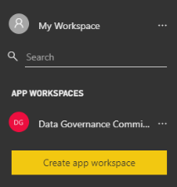
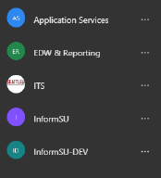
This is your own personal workspace for designing content within Power BI.
Subsequent Power BI trainings will facilitate use of this functionality. If you would like to start self-training sooner, click here.
Navigate
Navigating the Power BI Workspace
Home
Return
Favorites
These are locations where user groups can share reports and dashboards with other members of their groups.
These are workspaces you may collaborate on with other co-workers or user groups.
(The workspaces provided here are examples.)
Recent
Apps
Shared with me
Workspace
Get Data

Slide 30
Navigating the Power BI Workspace
Navigate
Home
Return
This is a quick link to ways to pull data into the Power BI service. For general users, this functionality will not be utilized. For other users, additional trainings will be available.
Favorites
Recent
Apps
Shared with me
Workspace
Get Data

Slide 31
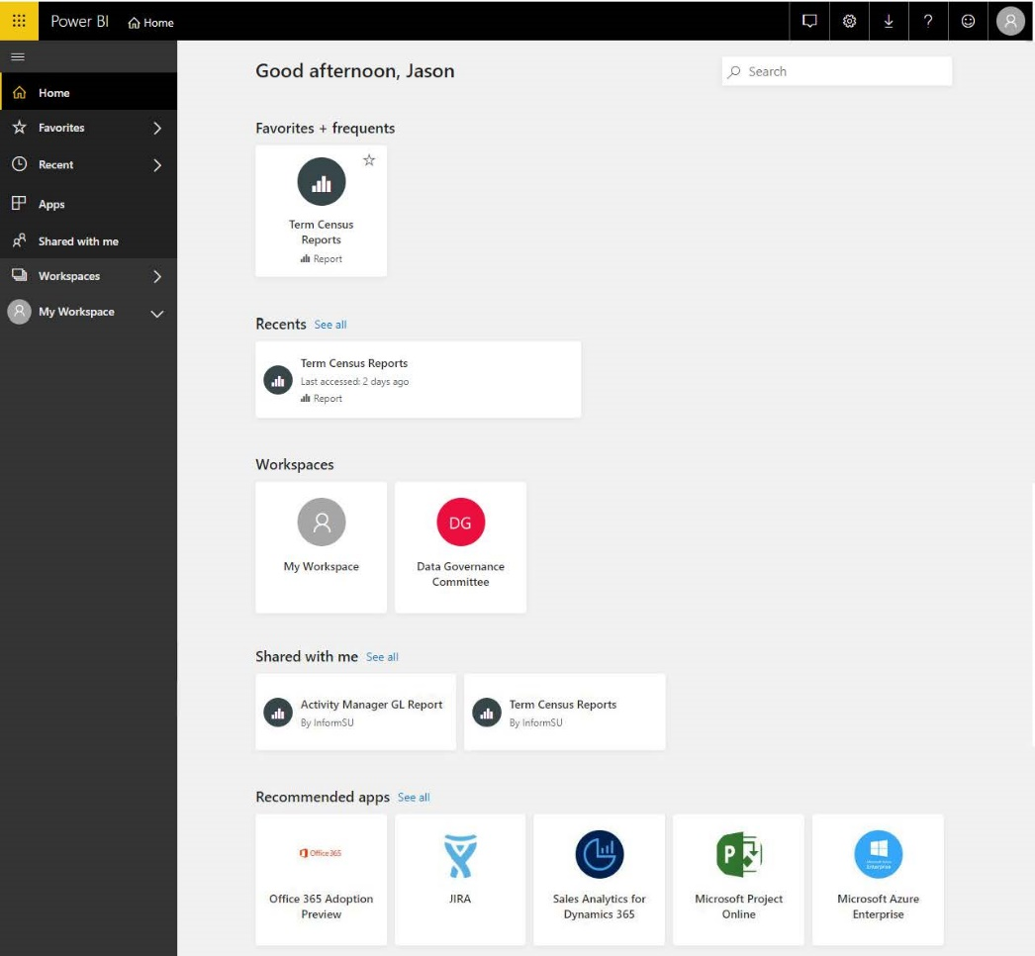
Opening a POWER BI Report
Navigate
Let’s open the Power BI report, Term Census Reports.
To open the Term Census Report example, click here.
The purpose of the Term Census Reports is to answer questions concerning enrollment data and trends over time at Seattle University.
For an understanding of how the Term Census Report used for this example was built, click here.

Slide 32
Term Census Reports
X
Opening a POWER BI Report
Prior to their integration into Power BI, enrolled student term census data were primarily used as the basis for Institutional Research official reporting, including the fall Fact Files. These data provide an overview of how enrollment and registration patterns change over time and across different student populations, including point-in-time views of each term’s enrollment, registration, and credits generated.
Let’s open the Power BI report, Term Census Reports.
To open the Term Census Report example, click here.
Data Overview
Data available in Power BI extends back to 2008-09 academic years to the current (2018-19) academic year and is available for every term, including summer. Information on basic student characteristics is displayed for each term as well as longitudinally. By-school/department/program/major information is also available for this period of time, also per term or for a series of terms/years. In addition, demographic characteristics as well as denomination reports are also available.
The purpose of the Term Census Reports is to answer questions concerning enrollment data and trends over time at Seattle University.
Methodology
The data used in these reports come from Institutional Research’s 10th day census data snapshots. Each term, IR works with the Registrar’s office to identify and rectify data issues and get an accurate count of enrolled students as of the 10th day of the term. The 10th day of the term is used since it for two reasons: it occurs after the last add/drop day of the term and it allows the Registrar’s office adequate time to update any additional data on students. The result is a consistent view of the data as of the start of each term.
For an understanding of how the Term Census Report used for this example was built, click here.
For more information on the Term Census Training Manual, email informsu@seattleu.edu.

Slide 33
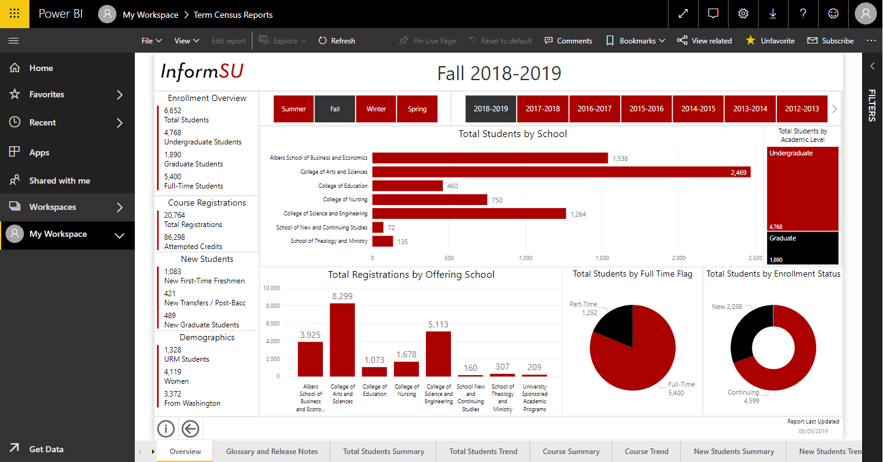
Overview of a POWER BI Report
Navigate
The Power BI Report will open within your Workspace within the Web App.
Continue
The Power BI tools will remain…
…while a new set of tools will appear at the top of the report.

Slide 34
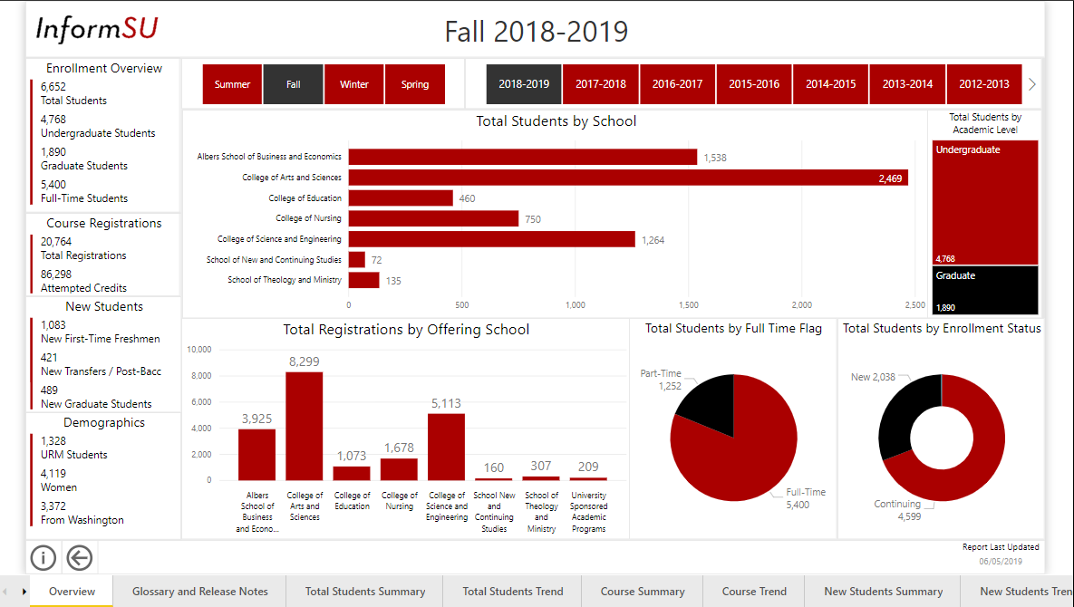
Sections of a POWER BI Report
Navigate
A Power BI Report is a collection of visualizations that appear together on one or more pages.
Continue
Visualizations present data in a simple way that provides context and insight.
Slicers let users select and manipulate the way data is visualized within a report.

Slide 35
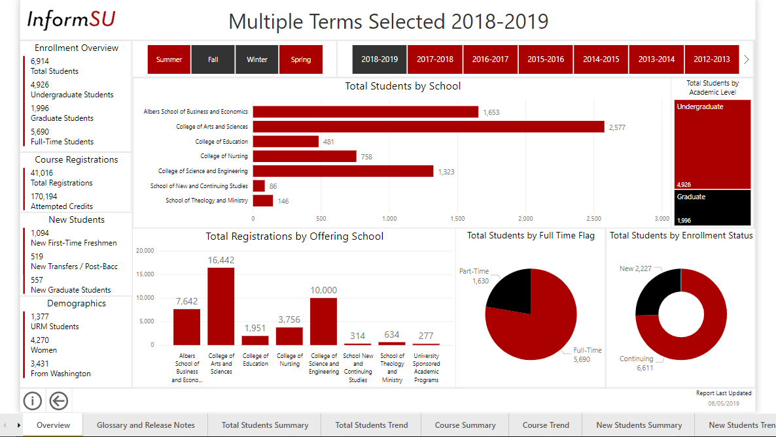
Applying Slicers to the Report
Navigate
Clicking on a slicer
changes how data
appears in a visualization.
The slicers Fall and 2018-2019 have been currently.
Continue
Select the slicer Winter to adjust the data being visualized.
The title on the report will also change with the application of a new slicer.

Slide 36
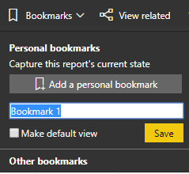
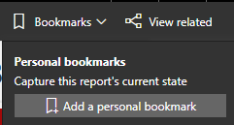
Saving and Clearing Slicers
Navigate
Sometimes you can apply a number of slicers to your dashboard to cross-reference a larger amount of data.
The Slicers have been reset.
Allows multiple
Only one at a time
Continue
Clicking on Bookmarks can let you save your slicer settings for reference later.
Clicking on Reset to Default returns your report to it’s original, default state.

Slide 37
Navigate
Suggestions for Exploring a Power BI Report
If each Power BI report is a little different, how can we learn to navigate them?
Since Power BI reports are assembled by different developers, the nuances of each Power BI report will be different from the next.
Here are some suggestions for navigating and exploring a new report and the ways it can visualize data.
Continue

Slide 38
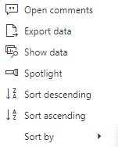
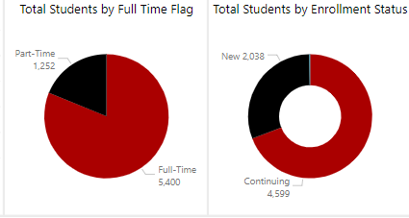
Hovering Over a Visualization
Navigate
Hovering your mouse over a visualization can bring up options for exploration.
Some visualizations have additional options when you move your mouse over them.
Focus Mode
Enlarges visualization to fill the screen
More Options
Brings up additional options
Open Comments
Allows public comments on data that EVERYONE can see
Export Data
Description
Show Data
Description
Spotlight
Description
Sort
Description
Pin to Report
Currently not supported
Continue
* not all tools will be immediately supported. Some will come later.

Slide 39
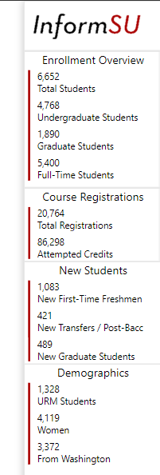
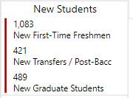
Visualizations as Cards
Navigate
Some visualizations are layered cards that show static data and help with navigation.
The “cards” in the Term Census Report actually assume two tasks: Representing data and Navigating the report.
Navigation Card
Clicking on the navigation card will take you to that location in the report.
Continue
When your mouse hovers over a card, it brings up a navigation card.
Go to New Student views
Static Data
Displays data affected by slicers that have been applied to the report
Go to New Student views

Slide 40
Training Resources
Navigate
Power BI training has been designed to introduce the new tool and the specific reports
and dashboards that will run on it.
The InformSU Power BI training resources include…
Introduction to Power BI Training Manual
Links to Microsoft provided manuals and video series
Power BI Activity Manager General Ledger Training Manual
Links to a Power BI Glossary
Updated InformSU Power BI office hours
InformSU contact information
Return to Home Screen
Questions? Consult the Power BI Training Resources by clicking here

Slide 41
End Presentation
End
Thank you for taking the time to learn about Power BI.
For more information or questions, please contact us at informsu@seattleu.edu.
End Presentation

